Slide 1


Population
A global perspective on NTA and Public Policy: The role and work of the United Nations
Jorge Bravo Sánchez
Population Policies and Development Branch, Population Division
UN DESA
Building Sustainable Generational Economies: The 14th Global Meeting of the NTA Framework
Session on NTA and Public Policy, Tuesday, 14 February 2023, Paris, France

Slide 2
Looking back, looking forward
The first Meeting of the Working Group on Macroeconomic Aspects of Intergenerational Transfers took place two decades ago (Berkeley, California, January 2004)
Initial applications of the National Transfer Accounts (NTA) methodology were on 5 countries or areas. Today, there 82 country teams, in all regions of the world
Notes:
As you all know (and Ron and Andy recalled this morning)…

Slide 3
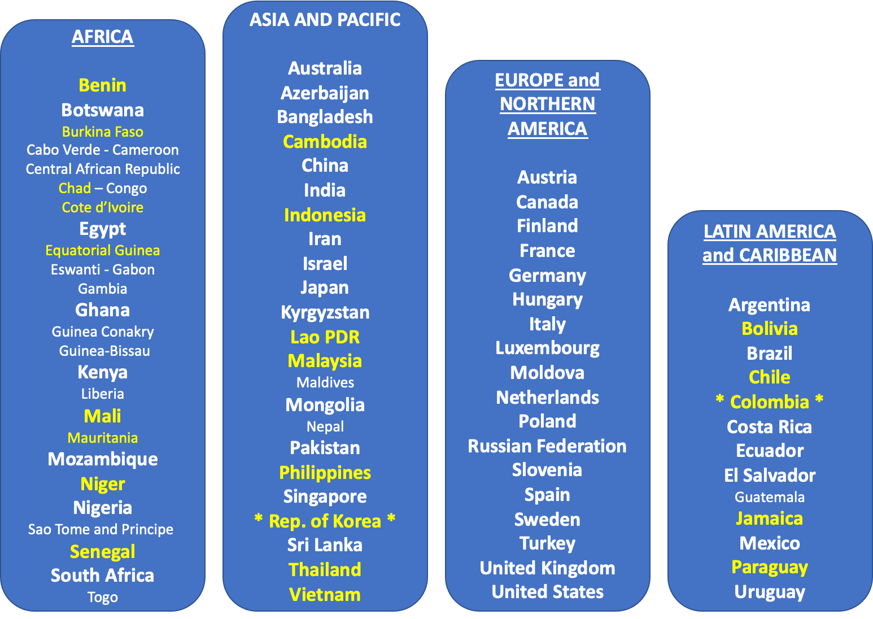
NTA Network
250+ Individuals
62 Country Teams
22 are led or co-led by national government;
2 NSOs have instituted NTA as part of official national statistics: Colombia and
Rep. of Korea.
Notes:
Highlight the teams that are led or co-led by national government offices, because of the mandate of the UN to support MS governments as well as academic research institutions

Slide 4
Looking back, looking forward
The United Nations was involved from the beginning, starting with work for Latin American countries in 2004 and integrating the results in subsequent global UN official meetings and reports
In the 2010s, the UN led a capacity development project to assist countries to implement the NTA methodology, and published the first NTA Manual: Measuring and Analysing the Generational Economy (2013)

Slide 5
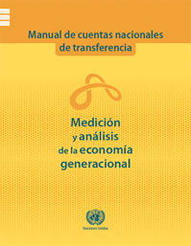
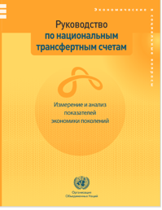
DESA Manuals
Measuring the Generational and Gendered Economy
BY AGE:
National Transfer Accounts (2013)
(2) BY GENDER:
National Time Transfer Accounts (2023)
(3) BY SOCIO-ECONOMIC GROUP:
National Inclusion Accounts
(2025)
Spanish
Russian
Notes:
If I were Tim Miller, I would note that the first manual on SNA, published by the UN in 1953, was written by Richard Stone, who went on to win the Nobel Prize in Economics! (in 1984).
This year, we will be publishing the 2nd manual on NTTAs, written mostly by Gretchen Donehower. A 3rd manual on NIAs, will be published in 2025

Slide 6
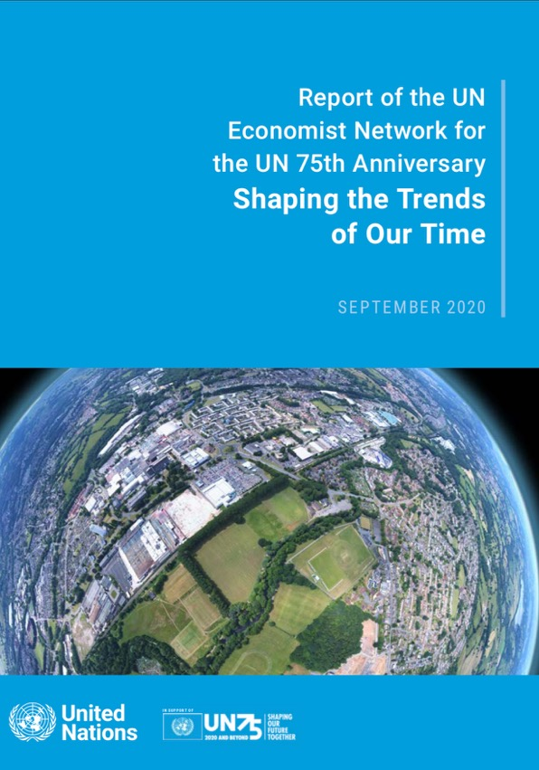
Like climate change, demographic shifts are a megatrend impacting sustainable development
UN Economist Network identified 5 megatrends impacting sustainable development:
climate change;
demographic shifts, particularly population ageing;
urbanization;
the emergence of digital technologies;
and inequalities.
Notes:
The UN has a role in setting international standards to measure and analyze the generational economy (its normative function), but also has an analytical function, and integrated the NTA approach, data & results to contribute into the analysis of global development trends – see the 2020 UN Economist Network publication

Slide 7
Capacity Development Support
on NTA sponsored by the United Nations
UN Secretariat:
DESA
ECA
ESCAP
ECLAC
ESCWA
UNFPA
Notes:
Third, in addition to its normative and analytical work, the UN undertakes operational work, in this case, by supporting capacity development of its Member States in the production and use on NTA

Slide 8
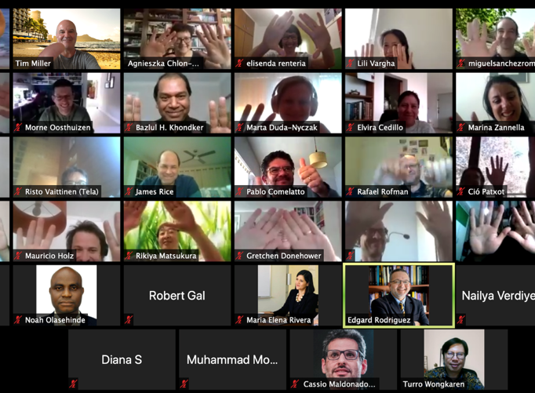
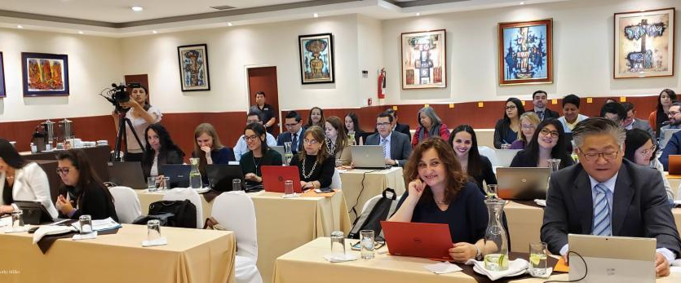
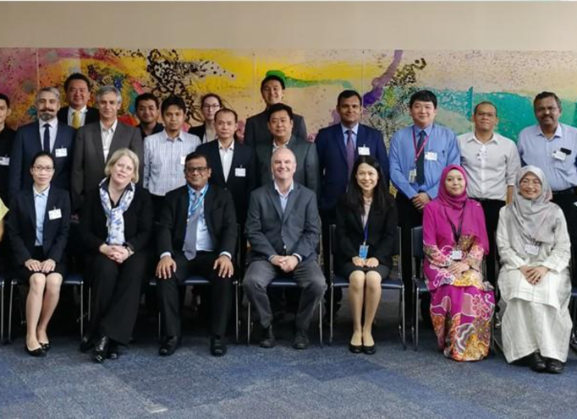
DESA
Training to Member States

Slide 9
Capacity Development Support
for NTA sponsored by the United Nations DESA
During the last 4 years, UN-DESA has led 7 training workshops on NTA: 4 national workshops in Colombia, Indonesia, Malaysia, and Mexico, and 3 regional workshops: 1 in Asia-Pacific and 2 in LAC.
Trained 214 participants from 22 countries (13 in LAC and 9 in Asia-Pacific).

Slide 10
Looking back, looking forward
The UN is starting in 2023 a new 4-year Development Account project that responds to the call by the Secretary-General to build and adopt long-term intergenerational thinking and planning, by
Developing National Inclusion Accounts (NIA), national accounts by age and socioeconomic status.

Slide 11
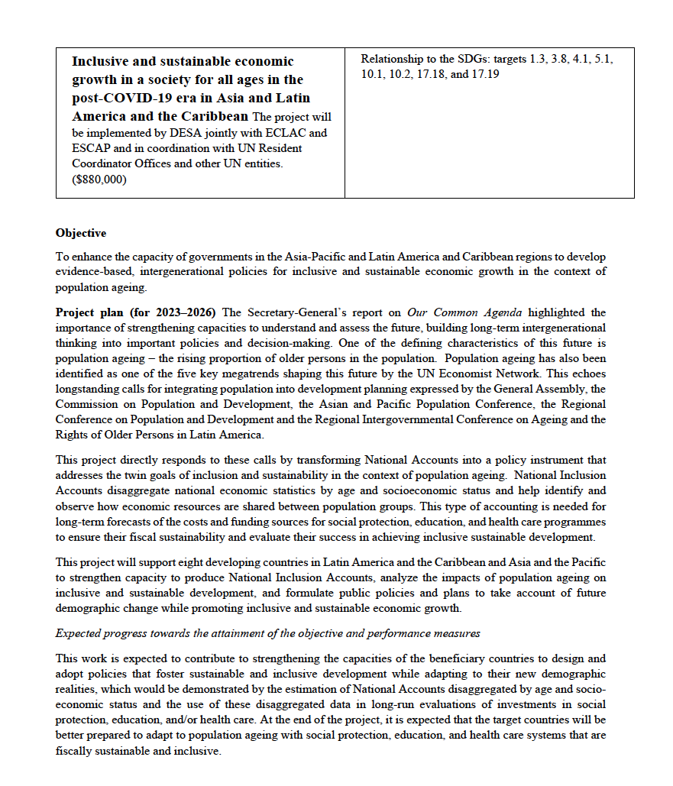
15th Tranche Development Account (2023-2026):
National Inclusion Accounts
(NTAs by educational attainment)
UN DESA-ECLAC-ESCAP pilot project 8 countries:
  Colombia, Costa Rica, Jamaica, Uruguay.
  Lao PDR, Malaysia, Maldives, Viet Nam.
Timeline
2023 | Method: Manual on National Inclusion Accounts Global Meeting
2024 | Data: Estimate National Inclusion Accounts National Workshops
2025 | Models and policies: Applications of National Inclusion Accts. Regional Workshops
2026 | Outreach: Presentation at Annual NTA Global Conference

Slide 12
4th Beyond GDP Sprint: Disaggregating National Accounts by age, gender, and socioeconomic group (2022)
https://unstats.un.org/unsd/statcom/groups/NetEconStat/GDPSprintFourthMeeting/
Age
National Transfer Accounts: Disaggregating National Accounts by age. Nicole Mun Sim Lai and Tim Miller. UN.
Colombia’s National Transfer Accounts: Insights and results. Juan Daniel Oviedo. DANE, Colombia.
Gender
Disaggregating National Accounts by age and gender. Gretchen Donehower, UC Berkeley.
Socioeconomic Group
Disaggregating National Transfers Accounts by education and income in Chile and Brazil. Cassio Turra, CEDEPLAR, Brazil.
Capturing wellbeing by disaggregating NTA and NTTA. Alexia Fürnkranz-Prskawetz. Vienna Institute of Demography.
Synthesis
How the disaggregated NTAs combine for a richer picture of the economy. Ronald Lee, UC Berkeley.
Notes:
All NTA related work (including NTTA and NIA) is contributing to the discussions on Beyond GDP.
We will hear more about these connections on the Friday 9 a.m. workshop on “How to measure inequality in National Accounts”

Slide 13
Population
Questions and suggestions:
Jorge Bravo bravo1@un.org and Tim Miller tim.miller@un.org

